Slide 1
Fun with Slurm and Azure CycleCloud

Slide 2
Agenda
What is Slurm?
Basic Slurm commands
Submitting a Job
Slurm + CycleCloud
Troubleshooting

Slide 3
What is Slurm?

Slide 4
What is Slurm
Slurm is an open source HPC software resource manager and job scheduler developed and maintained by SchedMD
Supports complex scheduling algorithms
Supports resource limits
Optimized for network topology
Used on many of the world’s largest supercomputers
Active global user community
Paid support provided through SchedMD

Slide 5
Slurm Design Goals
Highly scalable (up to millions of cores)
Open source
System administrator friendly
Secure
Fault-tolerant (no single point of failure in some configurations)
Portable

Slide 6
Slurm Terminology
Jobs: Resource allocation requests
Job steps: Set of (typically parallel) tasks
Typically an MPI, UPC, and/or multi-threaded application program
Allocated resources from the job’s allocation
Jobs can contain multiple job steps which are executed either concurrently or sequentially
Lighter weight than jobs
Partitions: Job queues with limits and access controls on a subset of nodes
Maps to a NodeArray in CycleCloud terms, and may map to one or more VM Scale Sets

Slide 7
Node State Information (requestable resources)
Baseboards, Sockets, Cores, Threads
CPUs (socket, core or thread count depending on configuration)
Memory size
Generic resources (with names, types, and counts, e.g. gpus)
Features (arbitrary string, e.g. OS version)
State (e.g. drain, down, etc.)

Slide 8
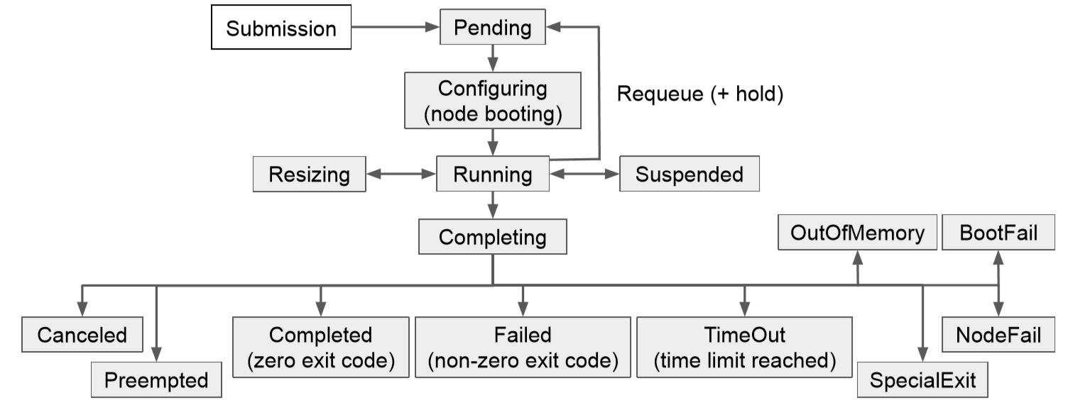
Job States

Slide 9
Daemons
slurmctld – Central controller (typically runs on “scheduler” node)
Monitors state of resources
Manages job queues
Allocates resources
Enforces policies
slurmd – Compute node daemon
Typically one per compute node
Launches and manages slurmstepd
Small and lightweight
Monitors local resources on compute nodes and reports back to slurmctld

Slide 10
Daemons
slurmstepd – Job step shepherd
Launched for batch job and each job step
Launches user application tasks
Manages accounting, application I/O, signals, etc.
slurmdbd – Database daemon (not configured by default prior to 8.1)
Collects accounting information
Manages user/group limits, fairshare, etc.

Slide 11
Basic Slurm Commands

Slide 12
Commands – General Info
Man pages available for all commands, daemons, and config files
--help option prints brief description of all options
--usage option prints a list of the options
Commands can be run on any node in the cluster
Any failure results in a non-zero exit code
Almost all commands have a single letter and verbose option
-p debug
--partition=debug
Almost all commands support verbose logging with –v
Use more v’s for more verbosity, e.g. -vvvv

Slide 13
Common Slurm Commands
sbatch – Submit a script for later execution (Batch mode)
Can submit a command directly with the `--wrap=“/bin/hostname”` argument
salloc – Create a job allocation and start a shell to use it (Interactive)
srun – Create a job allocation if needed and launch a job step
sattach – Connect stdin/out/err for an existing job step
scancel – Cancel a running or queued job
sinfo – View status of nodes in the cluster
squeue – View jobs in queue
scontrol – View/edit scheduler and node configuration

Slide 14
Submitting a Job

Slide 15
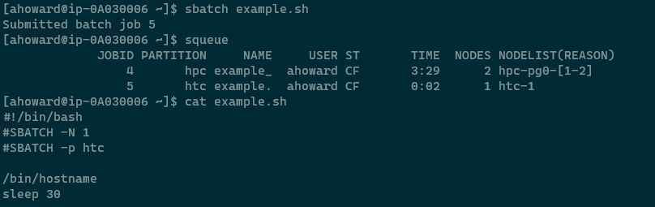
Example job script submission

Slide 16
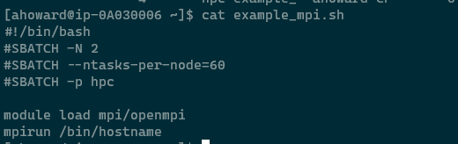

Example MPI job

Slide 17
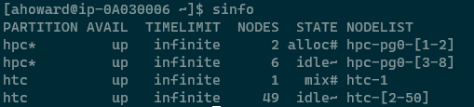
Monitoring/Checking nodes (sinfo)

Slide 18
Node State Codes (From man page of sinfo)
* The node is presently not responding and will not be allocated any new work. If the node remains non-responsive, it will be placed in the DOWN state (except in the case of COMPLETING, DRAINED, DRAINING, FAIL, FAILING nodes).
~ The node is presently in a power saving mode
# The node is presently being powered up or configured.
% The node is presently being powered down.

Slide 19
Slurm + CycleCloud

Slide 20
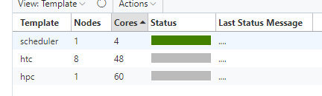
Differences from other cluster types
Requires all nodes in the cluster to be pre-defined in the config file
Starting a new cluster will create placeholder execute nodearrays in the “Off” state
Any changes to the cluster configuration require running the “cyclecloud_slurm.sh scale” command on the Scheduler
Major changes such as reducing the max size of a partition or changing machine types may cause running jobs to fail
“KeepAlive” button in CycleCloud doesn’t prevent nodes from being requested for shutdown by Slurm
Instead nodes or partitions need to be added to the SuspendExcNodes or SuspendExcParts list in slurm.conf

Slide 21
Autoscale integration
Uses Slurm’s “power save” mechanism
Slurm is responsible for deciding which nodes to start and stop and requests them by name from CycleCloud
Calls scripts in /opt/cycle/jetpack/system/bootstrap/slurm to resume and suspend nodes
Nodes manually stopped either via CycleCloud or via `shutdown` command will end up in the DOWN state and need to be manually set back to IDLE
Nodes in the DOWN state will not be considered by Slurm to be resumed

Slide 22
Upcoming features to Slurm in CycleCloud 8.1
Support for Slurm job accounting
Customers can opt-in to having CycleCloud set up job accounting to point to either a file on the Scheduler node or a MariaDB/MySQL database
Automatic detection and configuration of GPU resources
Will enable users to submit jobs requesting N number of GPUs
Multiple filer options for the shared filesystems on the cluster
Not unique to Slurm, but an often requested feature
Slurm 20 and CentOS 8 support

Slide 23
Troubleshooting

Slide 24
Debug log locations
Scheduler
/var/log/slurmctld/slurmctld.log
/var/log/slurmctld/resume.log
/var/log/slurmctld/suspend.log
/var/log/slurmctld/slurmdbd.log (only if customer has enabled SlurmDBD)
Nodes
/var/log/slurmd/slurmd.log

Slide 25
Config Files
Config files need to match on Scheduler and Execute nodes
Relevant config files actually live in /sched/ and are symlinked to /etc/slurm
/etc/slurm/slurm.conf
Created when CycleCloud first starts the Scheduler and then isn’t updated by Chef again
/etc/slurm/cyclecloud.conf
Created and managed by the cyclecloud_slurm.sh command
Any manual changes to this file could be reverted with future invocations of that command
/etc/slurm/topology.conf
Created and managed by the cyclecloud_slurm.sh command

Slide 26
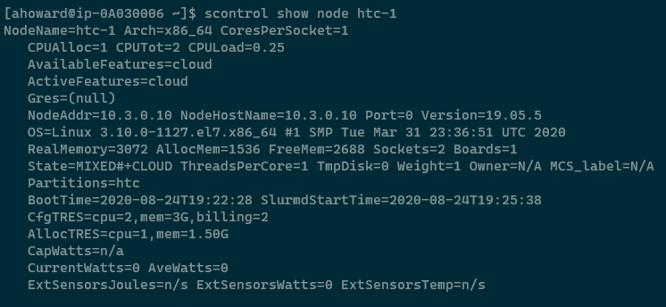
scontrol (running node)
Used to view and modify scheduler and node details
Primary tool for troubleshooting

Slide 27
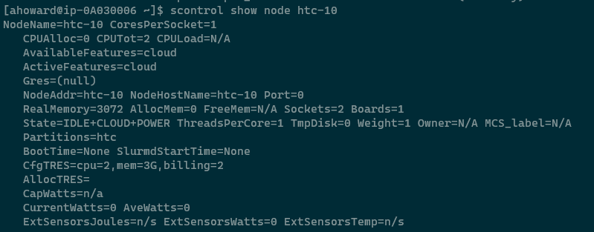
scontrol (power save)

Slide 28
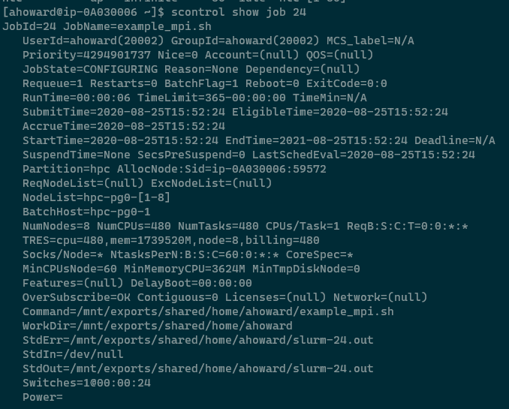
Scontrol (job)

Slide 29
scontrol (common commands)
Re-read configuration files
scontrol reconfig
View node information
scontrol show node <nodename>
View job information
scontrol show job <jobid>
Update node state (especially useful if nodes are marked DOWN)
scontrol update nodename=<nodename> state=idle

Slide 30
Common problems
“Autoscale used to work fine, but now Slurm won’t start nodes”
Check to make sure nodes are in the IDLE state and not DOWN
“My jobs ran fine on this cluster the past few days, but today the jobs keep dying”
Prior to CycleCloud 7.9.3 there was a bug related to IP reuse and some other Slurm settings. Make sure the customer has updated their Slurm cluster type to version 2.1.0 or later.
“I’ve updated my cluster configuration but Slurm doesn’t show the new nodes/nodetype/config”
Cluster changes require running the “cyclecloud_slurm.sh scale” command on the Scheduler to take effect.
Any running nodes may need to be terminated to pick up configuration changes
“I’m trying to configure job preemption/other advanced Slurm scheduling features”
Customer needs to reach out to SchedMD for support

Slide 31
Important slurm.conf settings (validate these are set)
SchedulerType = sched/backfill
SelectType = select/cons_res (or cons_tres)
SlurmctldParameters = idle_on_node_suspend
JobSubmitPlugins = job_submit/cyclecloud
PrivateData = cloud
TreeWidth = 65533
Include cyclecloud.conf

